Slide 1

Credit EDA Case Study
By – Sakshi Agarwal

Slide 2

Problem Statement
This case study aims to identify patterns which indicate if a client has difficulty paying their installments which may be used for taking actions such as denying the loan, reducing the amount of loan, lending (to risky applicants) at a higher interest rate, etc. This will ensure that the consumers capable of repaying the loan are not rejected. Identification of such applicants using EDA is the aim of this case study.
In other words, the company wants to understand the driving factors (or driver variables) behind loan default, i.e. the variables which are strong indicators of default. The company can utilize this knowledge for its portfolio and risk assessment.
To develop your understanding of the domain, you are advised to independently research a little about risk analytics - understanding the types of variables and their significance should be enough).

Slide 3

EDA Steps
Understanding the Domain/Variables
Read/Load the Dataset
Inspect the Dataframe/Check the structure of the data
Handling Missing Values
Handling Incorrect Column Datatypes
Handling Outliers
Handling Incorrect Values in data
Check the Imbalance Percentage/Ratio
Perform Univariate Analysis
Perform Bivariate Analysis

Slide 4
Handling Missing Values
Since there are lot of missing values in our dataset so below techniques are used to handle missing values –
Drop all the columns where missing values > 50 percent.
Remove all the records where missing value lies between 10 and 20 percent.

Slide 5
Handling Incorrect Column Datatypes
There were multiple columns with incorrect datatypes which has been converted to its relevant datatype.
Float Columns converted to Integer Datatypes.

Slide 6
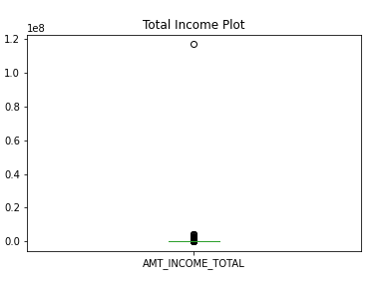
Handling Outliers
Outliers are the data points which are extremely high/low as compared to other data points in our dataset. They can be either removed/replaced with some other value.
For this case study – we have a client whose Total Income is close to 120M has been dropped from the dataset.

Slide 7
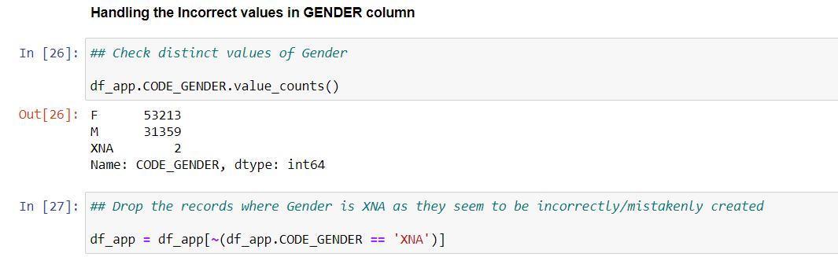
Handling Incorrect Values in Data
Incorrect Values namely XNA existed in GENDER column, so we removed them from the dataset.

Slide 8
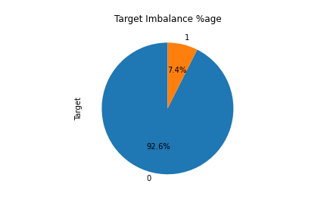
Imbalance Data Ratio
Imbalance Data is when one variable tends to have higher count/percent compared to the other.
For our case study – we have similar kind of behavior where no of clients with Payment difficulties have less datapoints as compared to other cases.

Slide 9
Strategy for Univariate/Bivariate Analysis
We would divide the whole dataset on the two types of TARGET variable and continue our analysis based on whether the client has faced any payment difficulties/not.

Slide 10
Creating Buckets for Analysis
Total Income column has been divided into 5 buckets of below range for the analysis –
VERY LOW : 0-100000
LOW : 100000-200000
MEDIUM : 200000-300000
HIGH : 300000-400000
VERY HIGH : 4000000-1000000

Slide 11

Univariate Analysis

Slide 12
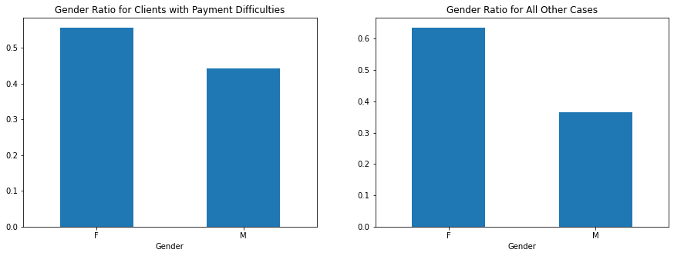
Gender Ratio Plot
Inference – Ratio of Female to Male client is lesser for loan payment difficulties as compared to other cases.

Slide 13
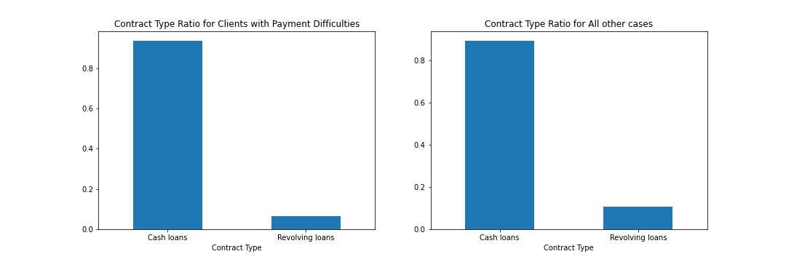
Contract Type Ratio Plot
Inference – Revolving Loans Contract Types are lesser in case of loan payment difficulties when compared with other cases.

Slide 14
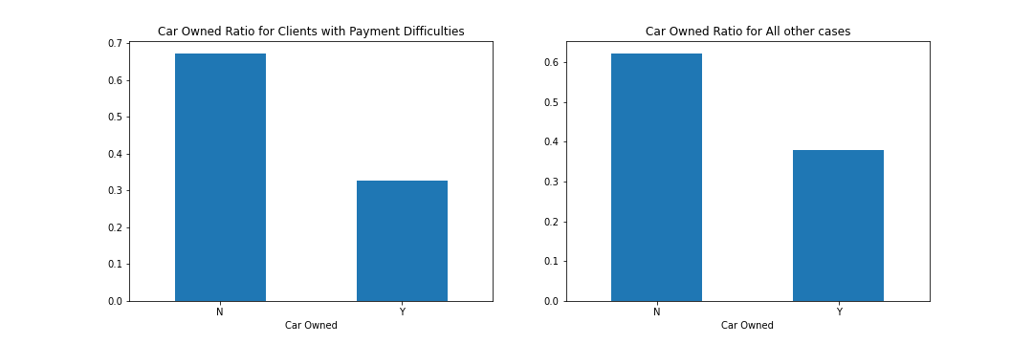
Car Owned Ratio Plot
Inference – People who don’t own a car are more in case of Payment difficulties as compared to other cases. Also, car owners are lesser in number when they have payment difficulties.

Slide 15
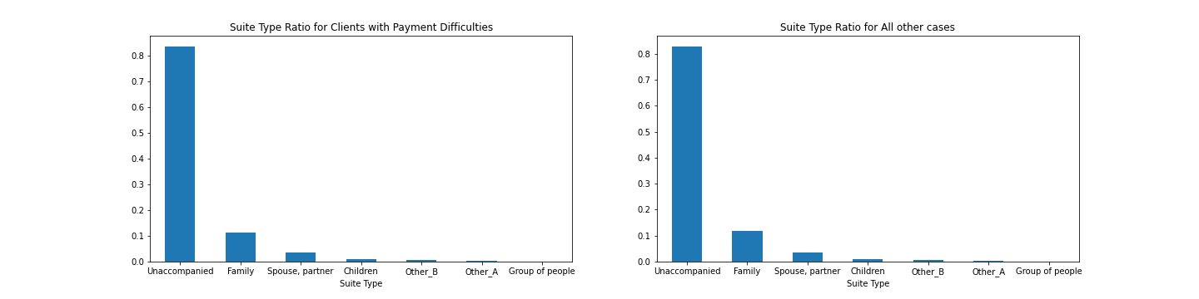
Suite Type Ratio Plot
Inference – Suite Type Ratio is almost similar for both the categories.

Slide 16
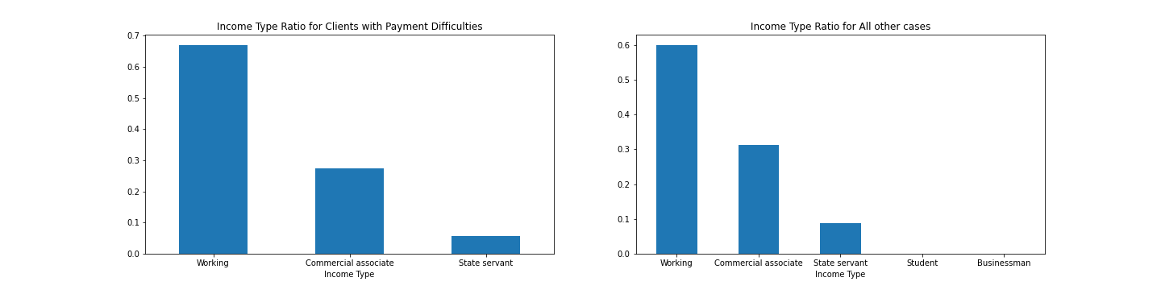
Income Type Ratio Plot
Inference – Working People tend to have Payment difficulties, Commercial Associates have less payment difficulties while Student and businessman do not have any payment difficulties.
Although total number of Student and businessman are very less in the dataset itself.

Slide 17
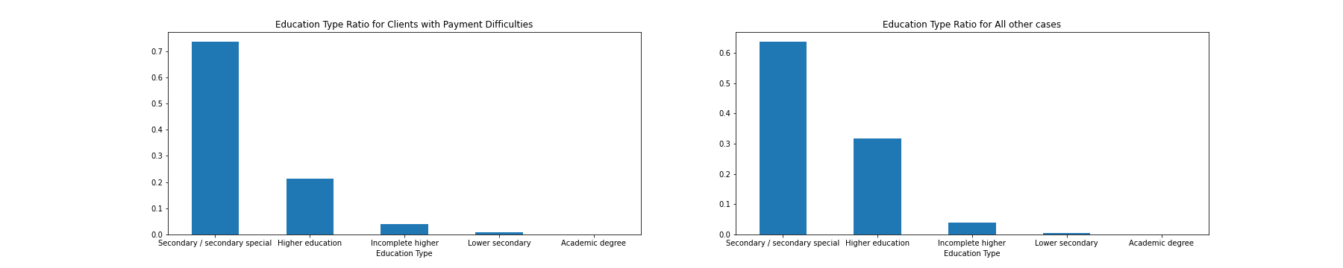
Education Type Ratio Plot
Inference – Secondary/Secondary Special Education Type people tend to have more payment difficulties when compared with others while Higher Education people have less payment difficulties.

Slide 18
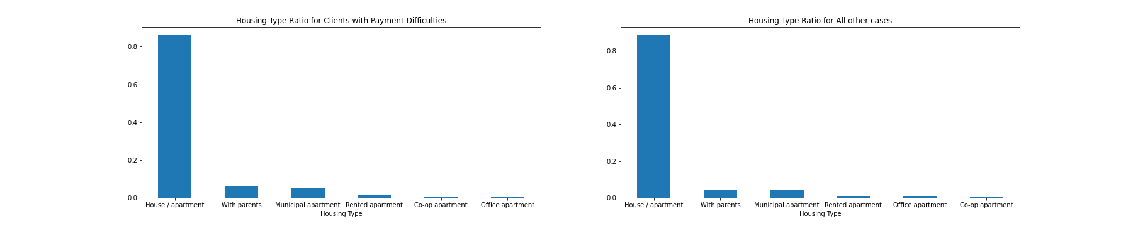
Housing Type Ratio Plot
Inference – People living in House/Apartment tend to have more payment difficulties when compared with people living with Parents/Municipal/Rented/Office Apartments.

Slide 19
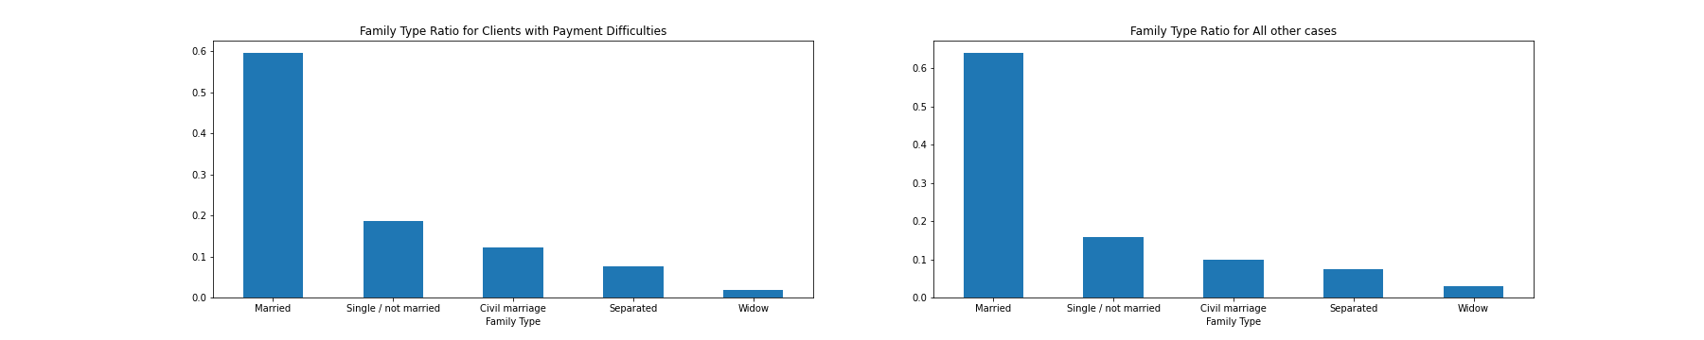
Family Type Ratio Plot
Inference – In the dataset provided, number of Married people are more. Though, Married people tend to have more payment difficulties when compared with Unmarried/Widow/Separated etc.

Slide 20
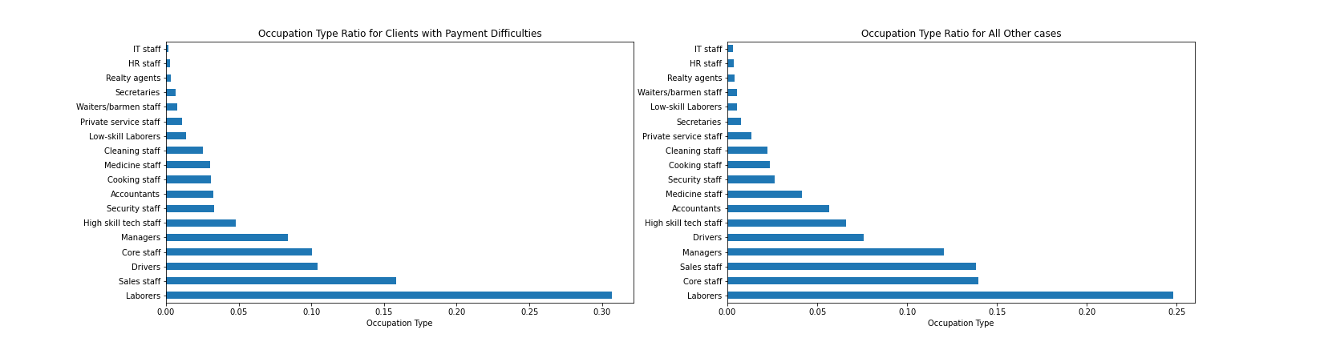
Occupation Type Ratio Plot
Inference – Laborers have more payment difficulties when compared with other Occupation Types.

Slide 21
Bivariate Analysis

Slide 22
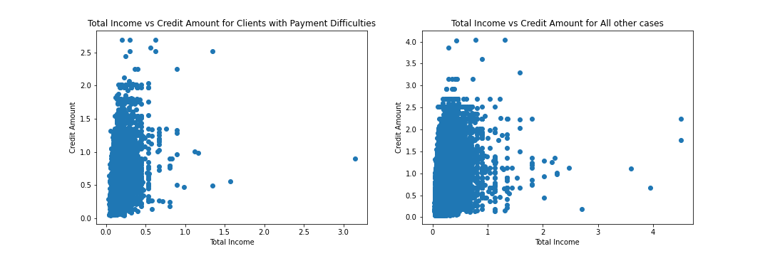
Total Income vs Credit Amount
Inference – Credit Amount did not show high correlation with total income in either of the categories.

Slide 23
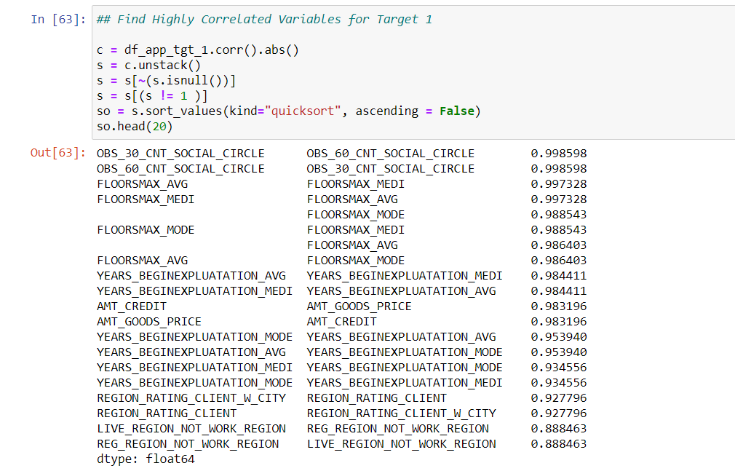
Correlated Variables for TARGET - 1

Slide 24
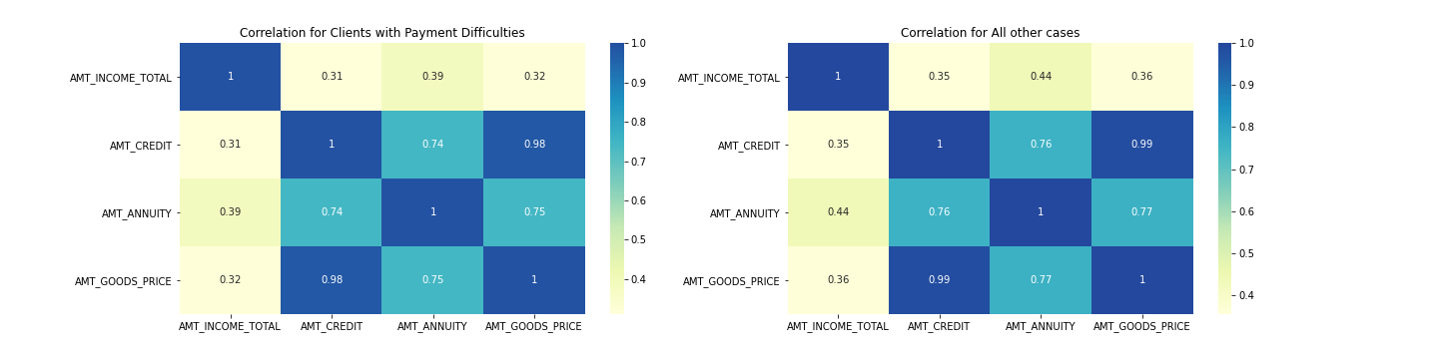
Correlation of Amount Variables
Inference – Credit Amount and Amt Goods Price are highly correlated while Total Income and Credit Amount have less correlation for both the categories.

Slide 25
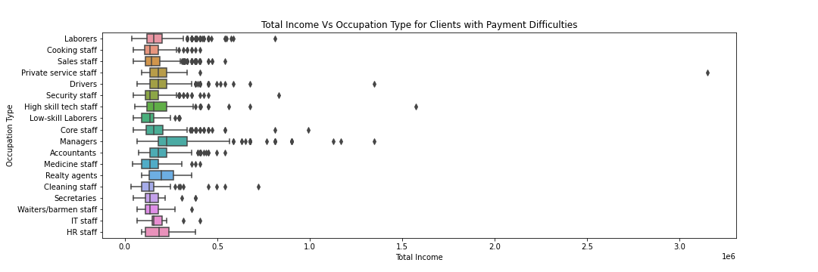
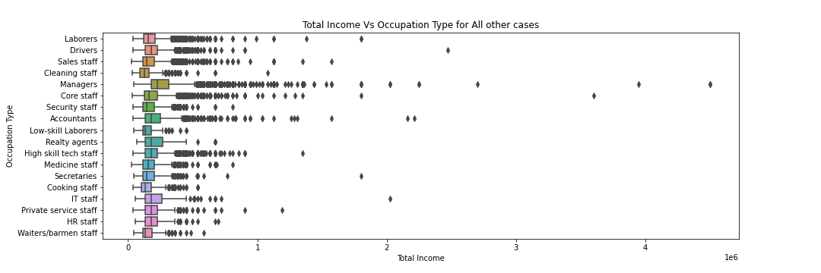
Total Income vs Occupation Type
Inference – Managers have higher Income as compared to other Occupations for both the categories.

Slide 26
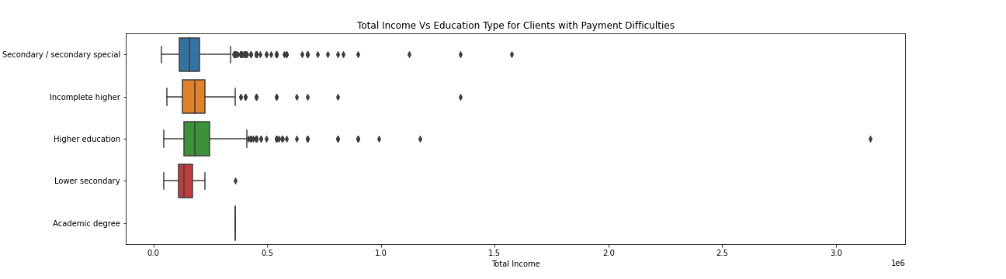
Total Income vs Education Type
Inference – Higher Education People have higher Income as compared to others for both the categories.

Slide 27
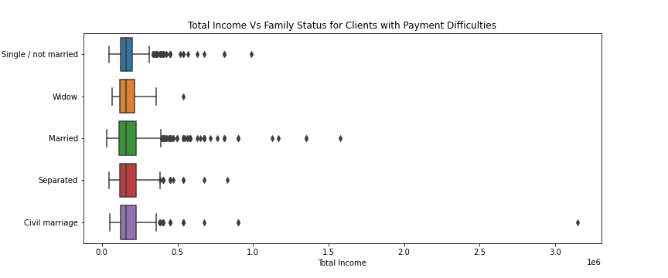
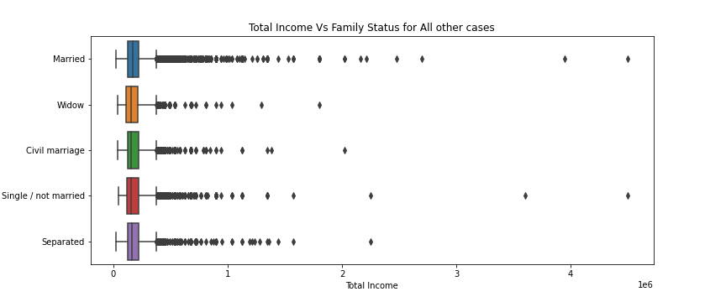
Total Income vs Family Status
Inference – Married People have higher Income as compared to others for both the categories.

Slide 28
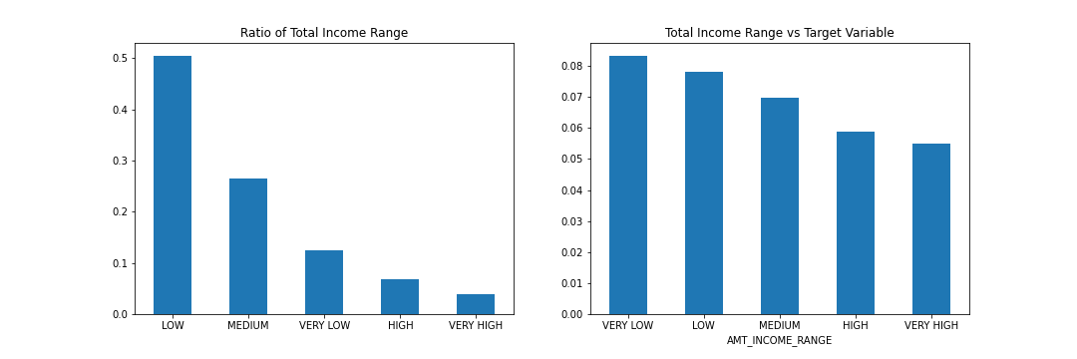
Total Income Range vs Target Variable
Inference – People falling in Very Low Income Range Category tend to have payment difficulties as compared to people in Very High Income Range Category. This graph clearly indicates the decrease in trend as the income rises/increases.

Slide 29
Conclusion
Almost 50% of the columns were dropped from application dataset due to missing values/not relevant for analysis.
Few columns were incorrectly defined in the dataset which were converted to its relevant type.
Incorrect values removed from the dataset s/a XNA present in Gender Column.
Total number of people with payment difficulties were very less as compared to other cases which signifies imbalanced data.
Focus should be more on Student/Businessman Income Type as they have successful loan re-payments.
Focus should be less on Secondary Educated People while more on Higher Educated People for successful loan re-payments.
Focus should be more on People living with parents/Rented/Office Apartments for successful loan re-payments.
Banks should focus less on Married People and more on Single/Separated etc for successful loan re-payments.
Banks should focus less on Laborers while more on others like High skilled staff/managers etc for successful loan re-payments.
People having Higher Income have less payment difficulties hence banks should target these people.

